Slide 1
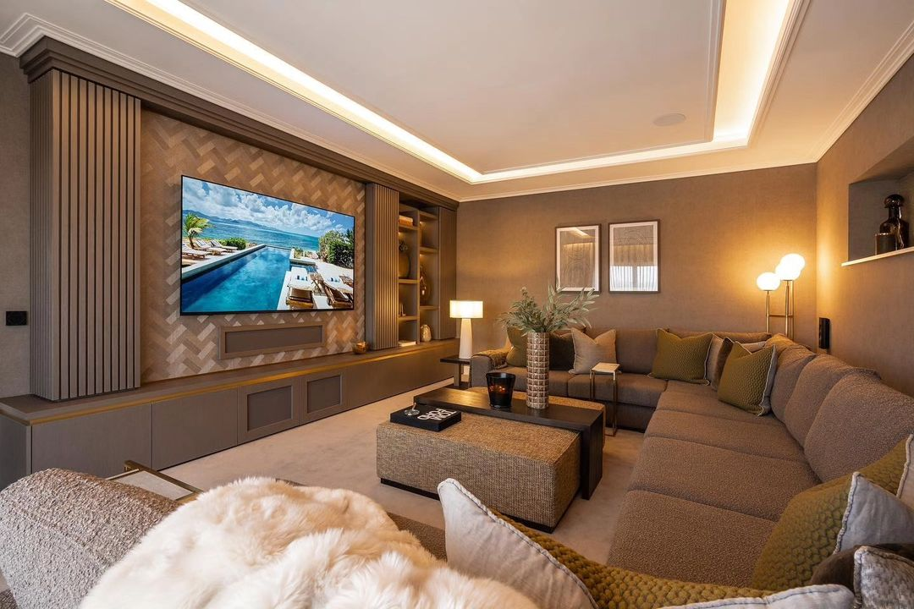
Living room
Sit Dolor Amet
A good and modern space where you can use it as both chilling and entertainment area for friends and family with a feel of modern luxury touch.

